Slide 1
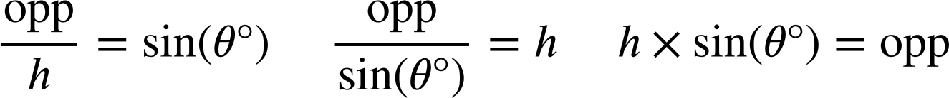
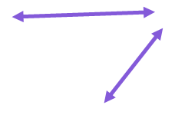
Using the sine ratio
Task A: Ratio tables, the unit circle, and tangents
1) Substitute the labelled sides and angle in each triangle into these two versions of the sine formula.
For each triangle, choose the most appropriate version of the sine formula to find the length of its missing side.
119
× sin( ) =
× sin( ) =
81°
a
b
49°
2
b cm
49°
a
119 cm
2
119
81°
b
2 cm
sin( )
=
sin( )
=
81°
49°
a cm = 117.53 cm
a cm
b cm = 2.65 cm
2) Match the triangle to the equation showing the relationship between its hypotenuse and an opposite side.
Use the equation to find the length of the missing side labelled x on each triangle (2 d.p.)
a)
b)
c)
x cm
32°
x cm
50 cm
50°
32 cm
32°
50 cm
50 × sin(32°) = x
x cm
e
x × sin(32°) = 50
32 × sin(50°) = x
d
x = 26.50
f
x = 94.35
The side opposite 32° has a length of 26.50 cm
x = 24.51
The hypotenuse has a length of 94.35 cm
The side opposite 50° has a length of 24.51 cm

Slide 2
Using the sine ratio
3) By using the sine formula, find the length of the missing side labelled with a letter for each of these triangles (2 d.p.)
a)
b)
c)
1 cm
a cm
14.9 cm
b cm
14.9 cm
c cm
39°
39°
49°
a = 0.63
b = 9.38
c = 11.25
d)
e)
f)
d cm
14.9 cm
e cm
41°
f cm
49°
49°
49 cm
14.9°
d = 19.74
14.9 cm
e = 22.71
f = 190.56
4) Find the lengths of the distances a, b, c, and d (rounded to the nearest integer).
44 cm
d cm
37 cm
10 cm
b cm
c cm
64 cm
50 cm
39.5 cm
a cm
44
cm
27°
23 cm
2

Slide 3
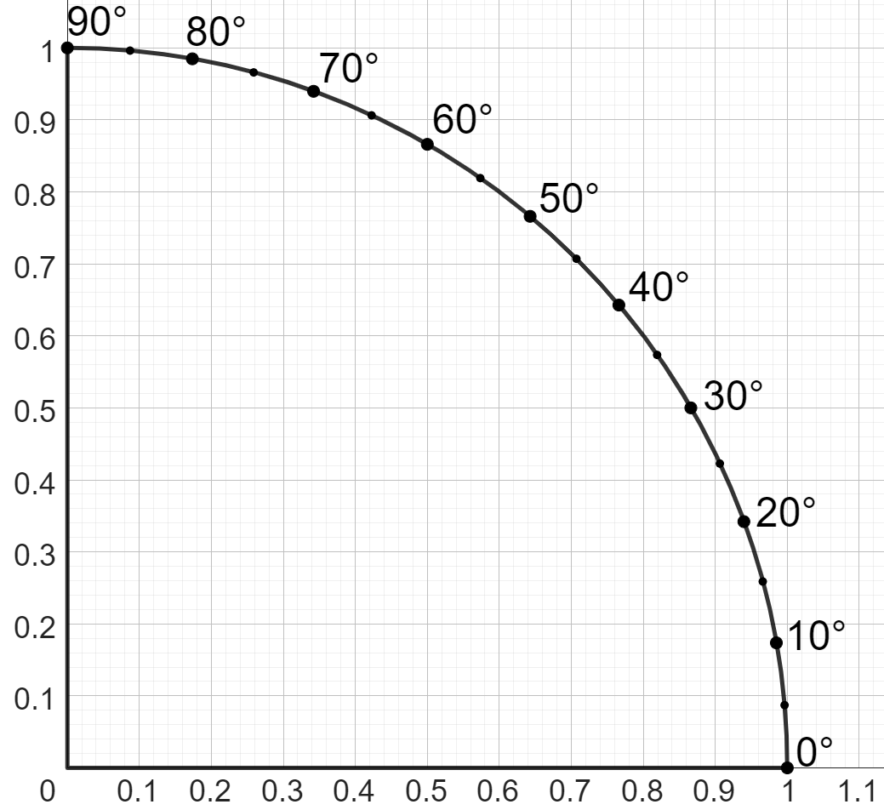
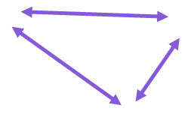
Using the sine ratio
Task B: Calculating angles using the sine formula
angle | sine | cosine | tangent
0 | 0 | 1 | 0
5 | 0.087 | 0.996 | 0.087
10 | 0.174 | 0.985 | 0.176
15 | 0.259 | 0.966 | 0.268
20 | 0.342 | 0.94 | 0.364
25 | 0.423 | 0.906 | 0.466
30 | 0.5 | 0.866 | 0.577
35 | 0.574 | 0.819 | 0.7
40 | 0.643 | 0.766 | 0.839
45 | 0.707 | 0.707 | 1
50 | 0.766 | 0.643 | 1.192
55 | 0.819 | 0.574 | 1.428
60 | 0.866 | 0.5 | 1.732
65 | 0.906 | 0.423 | 2.145
70 | 0.94 | 0.342 | 2.747
75 | 0.966 | 0.259 | 3.732
80 | 0.985 | 0.174 | 5.671
85 | 0.996 | 0.087 | 11.43
90 | 1 | 0 | ∞
1) Using this table of trig values, find the size of each missing angle marked with a letter.
25 cm
45.3 cm
20°
8.55 cm
65°
50 cm
sin(a°) =
8.55
=
0.342
sin(b°) =
45.3
=
0.906
25
50
0.866 cm
200 cm
5°
1 cm
60°
17.4
cm
2) By drawing appropriate lines on this part of a unit circle, estimate the size of each angle marked with a letter (to the nearest integer).
Any angle ± 2° of what is given is a sensible estimate.
sin(a°) =
12
=
0.8
12 cm
15
a° ≈
53°
15 cm
a°
42 cm
25 cm
17°
26°
11
cm
12.6 cm
3

Slide 4
Using the sine ratio
3) Use your calculator to find the size of each angle marked with a letter (1 d.p.)
24 cm
22 cm
b°
a°
9 cm
1 cm
0.48 cm
18 cm
c°
sin(a°) =
9
sin(b°) =
18
24
22
c° = 28.7°
a° = sin⁻¹(
9
)
=
22.0°
b° = sin⁻¹(
18
)
=
54.9°
24
22
e° = 73.7°
0.5 cm
3 cm
0.48 cm
0.5 cm
0.24 cm
d°
0.48 cm
f°
d° = 9.2°
e°
f° = 28.7°
Mathematics in Education and Industry
v2.3

